Slide 1
Programming basics
Jernej Vičič, Branko Kavšek
Introduction
0. lecture

Slide 2
We must start, somehow …
General information
Outlook
Index
Literature
Assessment method and criteria
Office_hours++
Some starting definitions
Modern computers desing
Summary
0. lecture
Programming
© Jernej Vičič, Branko Kavšek, UP FAMNIT
slide <number>/19

Slide 3
General information(1)
professor: Jernej Vičič
lecturer: Sead Jahić
e-mail: jernej.vicic@upr.si, sead.jahic@famnit.upr.si
e-classroom (Moodle):
https://e.famnit.upr.si
forum:
forum “Bla bla” on e-classroom
0. lecture
Programming
© Jernej Vičič, Branko Kavšek, UP FAMNIT
slide <number>/19

Slide 4
General information (2)
implementation: semestral
14 weeks lectures (thursdays)
ECTS: 6 credits
Important dates:
  Homeworks (e-classroom)
  Midterms (in the middle and at the end of semester)
  Exams at the end of the semester
0. lecture
Programming
© Jernej Vičič, Branko Kavšek, UP FAMNIT, 2012/13
slide <number>/19

Slide 5

Rationale
JAVA
learn the basics of problem solving;
become familiar with the basic concepts and techniques of programming;
familiarisation with basic data structures;
learn to express the process in a programming language;
understanding object-oriented programming;
learn about the abstractions in programming languages.
0. lecture
Programming
© Jernej Vičič, Branko Kavšek, UP FAMNIT, 2012/13
slide <number>/19

Slide 6
Fast forward …
introduction (that (was) it ☺);
problem solving basics;
programming languages’ basic building blocks;
array - polje (the most basic data structure);
recursion - rekurzija (and recursive function);
recursive data structures;
abstract data types / structures;
Abstractions;
files and file systems;
event-driven programming.
0. lecture
Programming
© Jernej Vičič, Branko Kavšek, UP FAMNIT, 2012/13
slide <number>/19

Slide 7
Literature (1)
Basic:
Handouts and slides from the lectures
JAVA tutorial: https://java.sun.com/docs/books/tutorial/
Additoonal:
Paul Vickers: How To Think Like A Programmer: Problem-solving for the Bewildered. Course Technology, 2008.
Paul Vickers: How To Think Like A Programmer: Program Design Solutions for the Bewildered. Course Technology, 2009.
Joyce Farrell: Programming Logic and Design. Course Technology, 2008.
Uroš Mesojedec, Borut Fabjan: Java2: temelji programiranja. Pasadena, 2004.
0. lecture
Programming
© Jernej Vičič, Branko Kavšek, UP FAMNIT, 2012/13
slide <number>/19

Slide 8
Literature (2)
Additional:
Michael T. Goodrich, Roberto Tamassia: Data Structures and Algorithms in Java, John Wiley & Sons, 2006, 4. izdaja.
John C. Mitchell: Concepts in Programming Languages, Cambridge Univ. Press, 2003.
Herbert Schildt: Java 2: the complete reference, Berkeley, Osborne/McGraw-Hill, 2001.
Thomas H. Cormen, et al.: Introduction to Algorithms, 2. izdaja, MIT Press, 2001.
0. lecture
Programming
© Jernej Vičič, Branko Kavšek, UP FAMNIT, 2012/13
slide <number>/19

Slide 9
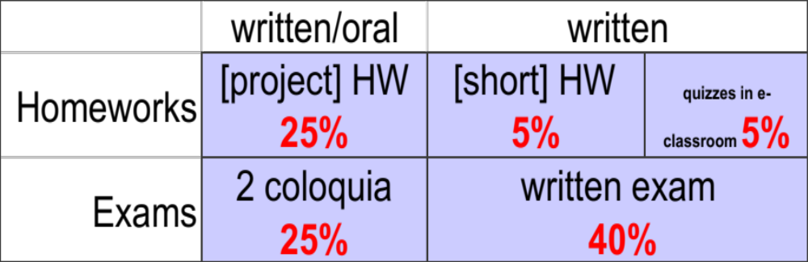
Grading
How is the final grade constructed?
Additional: oral exam
Sum: 100%
0. predavanje
Programiranje I / Računalništvo I
© Jernej Vičič, Branko Kavšek, UP FAMNIT
prosojnica <number>/19

Slide 10
Grading, follows
The minimum standards for each part of the grade:
project HW – delivered on-time and successfully defended
  (oral defense acounts for 50% of this part of the grade),
  average grade of all Project HW ≥ 20%,
quizzes – quizzes will appear right after selected lectures (less that 10),
  no minimum,
short HW – at least three quarters of all HW must be submitted (≥ 75%),
(75% is worth 0%, linear increase to 100%=5%).
0. predavanje
Programiranje I / Računalništvo I
© Jernej Vičič, Branko Kavšek, UP FAMNIT
prosojnica <number>/19

Slide 11
Grading, follows
The minimum standards for each part of the grade:
colloquium – programmed directly on the computer,
  both colloquia must be graded better or equal to 40% (≥ 40%),
written exam – better or equal to 50% (≥ 50%).
0. predavanje
Programiranje I / Računalništvo I
© Jernej Vičič, Branko Kavšek, UP FAMNIT
prosojnica <number>/19

Slide 12
Criterium
Each part of the grade has to be:
  projects – developed and submitted on time, (oral defense acounts for 50% of this part of the grade)
  written exam >= 50%
  oral exam
0. lecture
Programming
© Jernej Vičič, Branko Kavšek, UP FAMNIT
slide <number>/19

Slide 13
Grading, follows
Percentage | Grade
<50 | null
50 – 64 | 6
65 – 74 | 7
75 - 84 | 8
85 - 94 | 9
95 - 100 | 10
0. predavanje
Programiranje I / Računalništvo I
© Jernej Vičič, Branko Kavšek, UP FAMNIT
prosojnica <number>/19

Slide 14
Office hours
By arrangement (ZOOM): preferably in the evening - if possible in larger groups
In addition to the already mentioned methods of communication, for really crisis cases also…
0. predavanje
Programiranje I / Računalništvo I
© Jernej Vičič, Branko Kavšek, UP FAMNIT
prosojnica <number>/19

Slide 15
Definitions (1)
PROGRAMIRANJE
  Programiranje je spretnost v implementaciji enega ali več, med seboj povezanih, abstraktnih algoritmov z uporabo določenega programskega jezika in ima za cilj izdelavo konkretnega računalniškega programa. Programiranje vsebuje elemente umetnosti, znanosti, matematike ter inženirstva.
PROGRAMMING
  Computer programming (often simply programming) is the craft of implementing one or more interrelated abstract algorithms using a particular programming language to produce a concrete computer program. Programming has elements of art, science, mathematics, and engineering.
Resource: en.wikipedia.org/wiki/ProgramMing
0. lecture
Programming
© Jernej Vičič, Branko Kavšek, UP FAMNIT
slide <number>/19

Slide 16
Definitions (2)
PROGRAMSKI JEZIK
  Programski jezik je umetni jezik, ki se uporablja za nadzorovanje obnašanja strojev, še posebej računalnikov.
PROGRAMMING LANGUAGE
  A programming language is an artificial language that can be used to control the behavior of a machine, particularly a computer.
Resource: http://en.wikipedia.org/wiki/Programming_language
0. lecture
Programming
© Jernej Vičič, Branko Kavšek, UP FAMNIT
slide <number>/19

Slide 17
Definitions (3)
(RAČUNAL.) PROGRAM
  (Računalniški) program je zbirka ukazov, ki opisujejo neko nalogo ali množico nalog, katere naj se izvajajo na določenem računalniku.
COMPUTER PROGRAM
  A computer program is a collection of instructions that describes a task, or set of tasks, to be carried out by a computer.
Resource: http://en.wikipedia.org/wiki/Computer_program
0. lecture
Programming
© Jernej Vičič, Branko Kavšek, UP FAMNIT
slide <number>/19

Slide 18
Definitions (4)
Programming is:
  skill,
  engineering skill,
  art,
  science
    mathematics,
    computer science?
    ??
Resource: Jernej
0. lecture
Programming
© Jernej Vičič, Branko Kavšek, UP FAMNIT
slide <number>/19

Slide 19
The architecture of a modern computer
von Neumann-ov model
memory
processor
data
memory
program
memory
bus
input
unit
output
unit
I/O unit
0. lecture
Programming
© Jernej Vičič, Branko Kavšek, UP FAMNIT
slide <number>/19

Slide 20
Summary
What did we just learn?
The implementation of the Computer Programming class.
Some basic definitions (from "Wikipedia").
The architecture of (modern computers).
What wil we learn in this class?
The solving process (with computer) for same (specific) problems.
0. lecture
Programming
© Jernej Vičič, Branko Kavšek, UP FAMNIT
slide <number>/19

Slide 21
Resources
http://en.wikipedia.org/wiki/Computer_program
http://en.wikipedia.org/wiki/ProgramMing
http://en.wikipedia.org/wiki/Programming_language
0. lecture
Programming
© Jernej Vičič, Branko Kavšek, UP FAMNIT
slide <number>/19

Slide 22
First task – quiz
(Computer) programs are "talking" in programming languages ​​(PL), and people in natural languages​​. How would the "human" world describe the following terms from the computer world?
programming
program
syntax of a PL
Can you think of a term in the computer world and its 'double' in the 'human' world?
0. lecture
Programming
© Jernej Vičič, Branko Kavšek, UP FAMNIT
slide <number>/19

